Slide 1
Destabilising nations and individuals
Garry Robson
Notes:
A central component of the war being waged against us

Slide 2
A revolutionary ‘Great Reset’ Everything must change: all that is solid melts into air

Slide 3
Intro
Technocracy
Cultural Marxism and ‚Woke’ (‚stakeholder’) capitalism; ‚Woke’ as a weapon and a new religion
Destabilising nations
Manipulating children

Slide 4
1. TECHNOCRACY
No democracy/elections
Rule by scientists, engineers
Experts manage the economy and population
IoBT- based Surveillance: you cannot manage what you cannot monitor

Slide 5
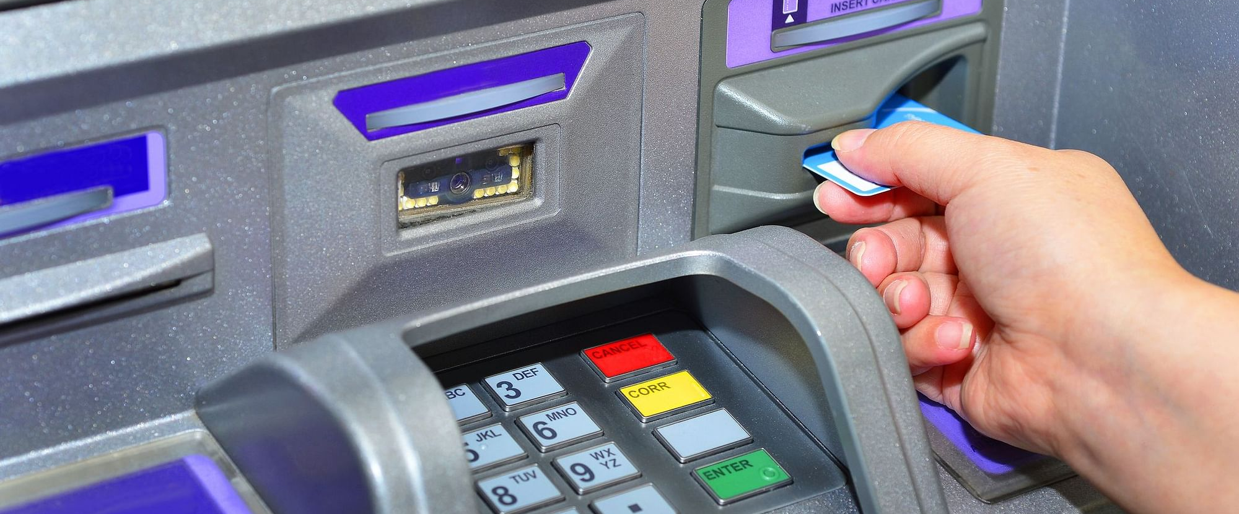
A depersonalised technological system
Notes:
Algorythmic management.

Slide 6
Notes:
for social and economic control

Slide 7
Technocracy
Notes:
TC, surveillance and techno-management will soon be possible.
UN Rio 92.

Slide 9
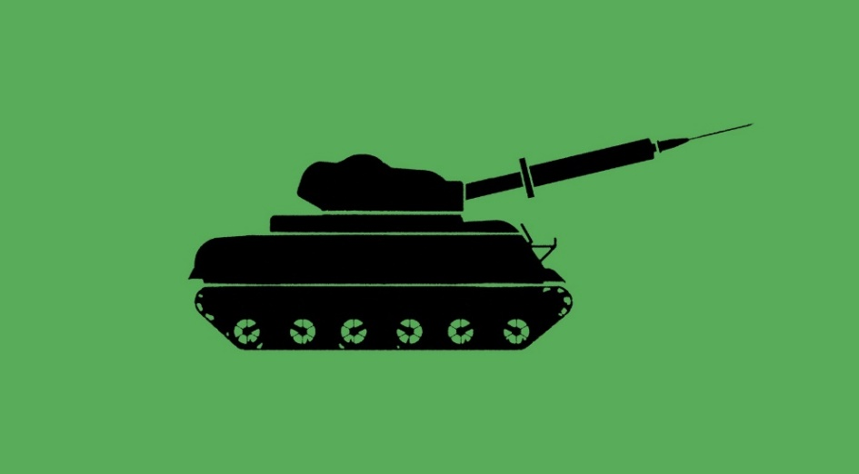
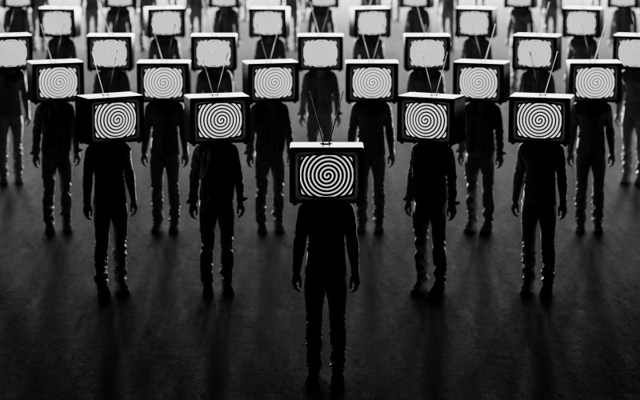
Hybrid/4th generation warfare Psychological conditioning: your mind is the battleground Full-spectrum dominance
Notes:
A strategy fir trying to move us into the Technocracy

Slide 10
2. Cultural Marxism and ‚woke’

Slide 11
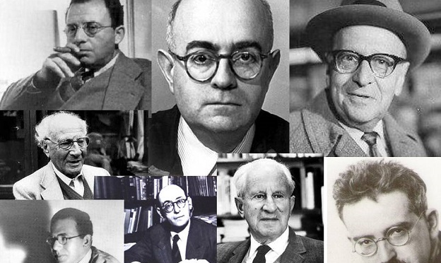
Antonio Gramsci
Frankfurt School
Notes:
No demand for proletarian revolution – false consciousness
Change the way people think through in the cultural sphere

Slide 12
e.g. 1990. Heteronormativity Gender is a cultural script

Slide 13
‘Woke’ capital and corporations swing left
Notes:
Big Money likes atomised, bewildered and ungrounded individuals.
Fragmented societies bring more alienation, internal conflict, are less stable, the population as a whole is weaker. Social solidarity and social trust weakens, original communities less resilient.

Slide 14
‘Wokeness’ as a new civil religion. The new Trinity: diversity equity sustainability

Slide 16
On the right here we see trans-homophobic police horses, which refuse to walk over the rainbow street crossings in the UK.

Slide 17
Compliance with the sustainable development programme and ‚woke’ propaganda and practices is being monitored and enforced from the top down, through the corporate ESG system; non-compliant entities are punished financially.

Slide 18
3. Destablising nations

Slide 19
UK context. Paul Gilroy: it is a bad idea for governments, municipal authorities and other institutions to try and shape and control how people from different ethnic backgrounds should relate to one another. If they are left alone to work it out for themselves, in many cases they will produce an organic ‚convivial’ culture. Top-down political initiatives are counter-productive.
Notes:
Multiculturalism pre=super diversity.
Settled, organic multi-ethnic communities not being controlled from the top down.

Slide 20
Notes:
An Orwellian statement.

Slide 22
E Pluribus Unum: Diversity and Community in the Twenty-first Century. The 2006 Johan Skytte Prize Lecture Robert D. Putnam
Notes:
A top-level sociologist conducts research into the effects of high levels of cultural diversity in neighbourhoods on social trust and solidarity in the US. The results disturb him.

Slide 23
Reductions in social solidarity, social capital, and social trust
In ethnically diverse neighbourhoods residents of all races tend to ‚hunker down’

Slide 24
Multiple research projects have tested Putnam’s findings. The one at the bottom here is a ‚meta-analysis’ of 87 such studies. It strongly confirms Putnam’s discovery that high diversity correlates with low social trust.
Trust, Inequality and Ethnic Heterogeneity: https://onlinelibrary.wiley.com/doi/a...
Ethnic Diversity and Social Trust Evidence from the Micro-Context: https://politicalscience.ku.dk/staff/...
Civic Engagement and Community Heterogeneity: An Economist's Perspective: https://www.jstor.org/stable/3687816#...
Robert Puttnam - E Pluribus Unum: Diversity and Community in the Twenty-first Century: https://www.puttingourdifferencestowo...
The Social Effects of Ethnic Diversity at the Local Level: A Natural Experiment with Exogenous Residential Allocation: https://www.journals.uchicago.edu/doi...
Ethnic Diversity and Social Trust: A Narrative and Meta-Analytical Review: https://www.annualreviews.org/doi/pdf...

Slide 25
Sir Trevor Phillips, a prominent public figure in the UK, has suggested on numerous occasions that parts of the country are now ‚Balkanised’ like the former Yugoslavia. He foresees potentially serious social disintegration in the future unless something is done now to address this situation.

Slide 26
The Dalai Lama is concerned about the ways in which the human ecological-cultural balance and social harmony are being disturbed.

Slide 27
The Global Compact for Migration is the first inter-governmental agreement covering international migration in a holistic and comprehensive manner.
Notes:
Not a treaty but a set of non-binding agreements. Countries observing the spirit of the compact must now take in and process all persons presenting themselves at a border as refugees. Most of the countries in the world signed the compact. 5 did not: Poland, US (under Trump), Hungary, Czech Republic, Israel. 11 others abstained.

Slide 28
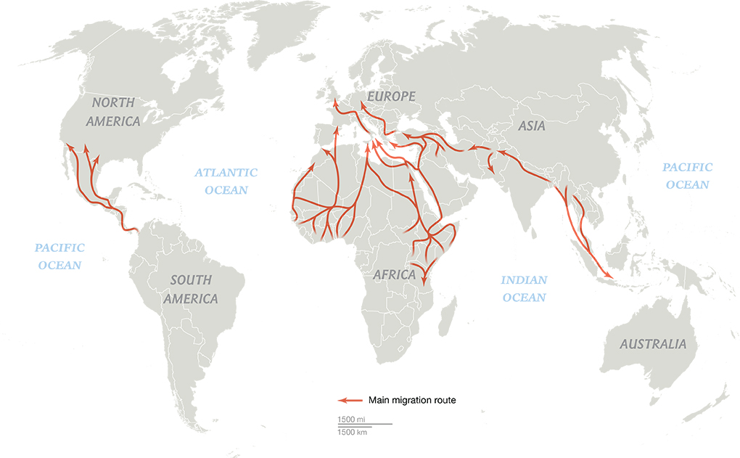
A system of managed population transfer, primarily from the global south to the north. Faciitated by the NGO complex.

Slide 29
…and ‚public-private’ partnerships (WEF-style ‚stakeholder’ capitalism): corporations take on what were previously the responsibilities of the state, and make big money from public money. Housing is the most central element. Companies like Serco are taking over the UK rented-accommodation sector.
Asylum accommodation and support services
Government outsources responsibility for managing incoming migrants to private contractors
2.9 billion (sterling) contract for SERCO, 2018

Slide 30
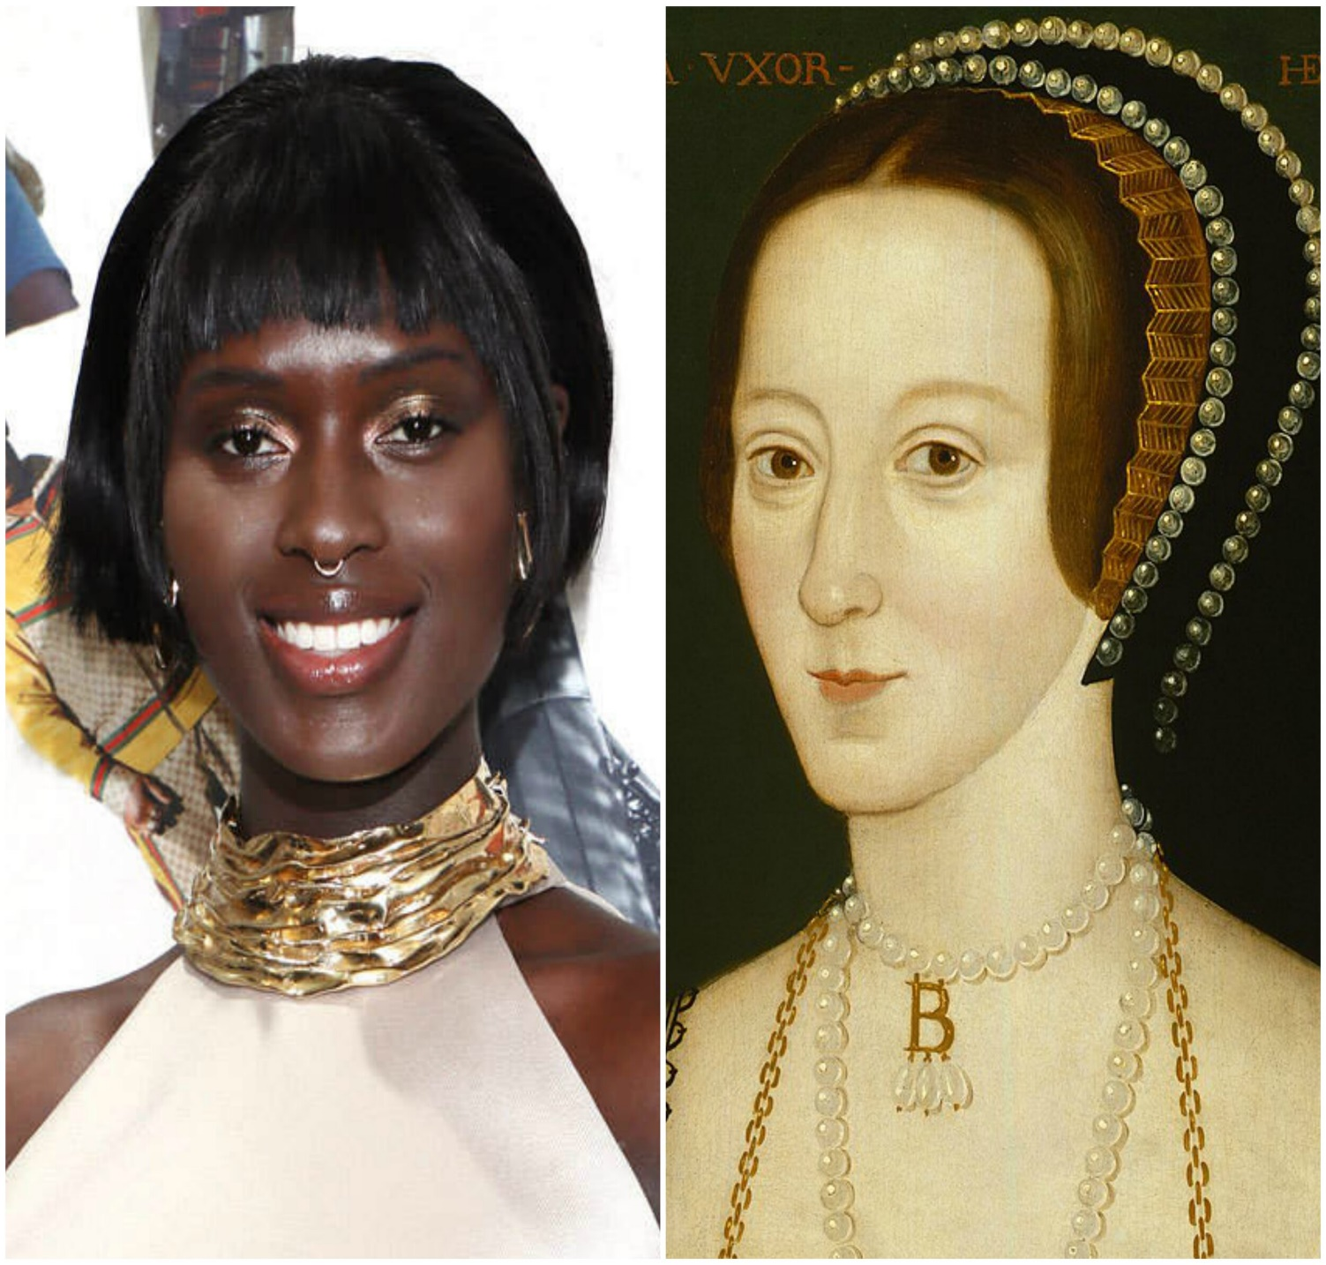

Slide 32
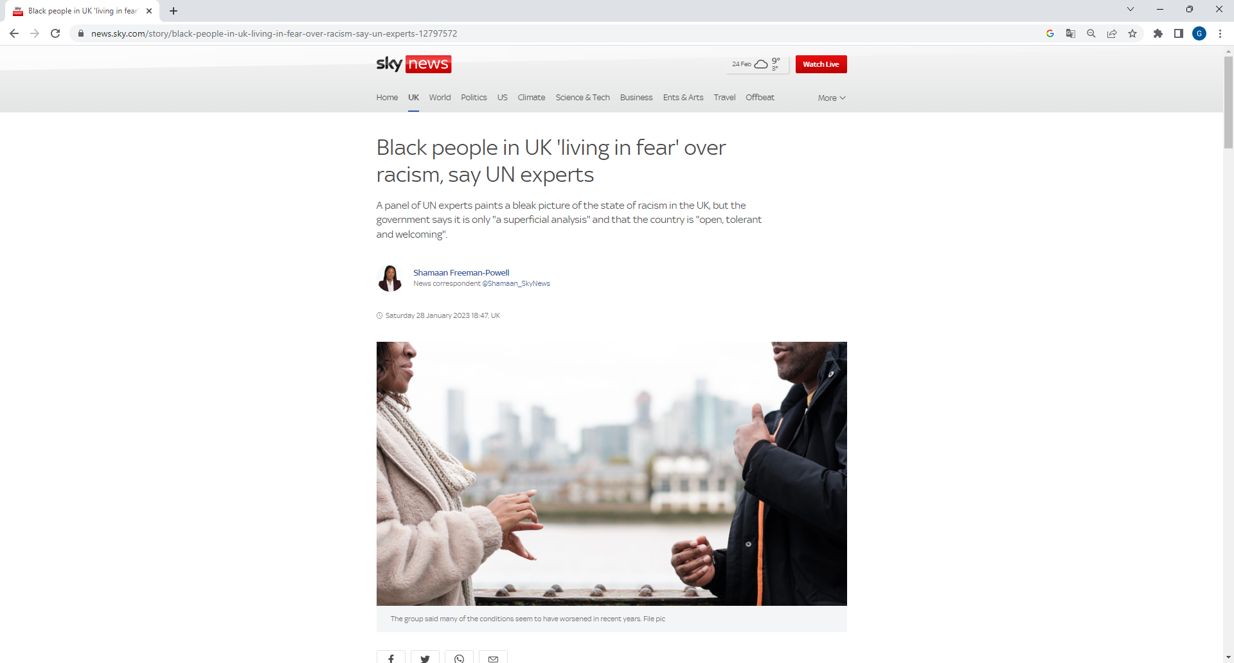
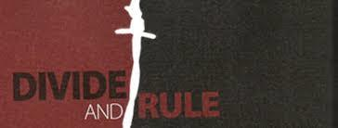
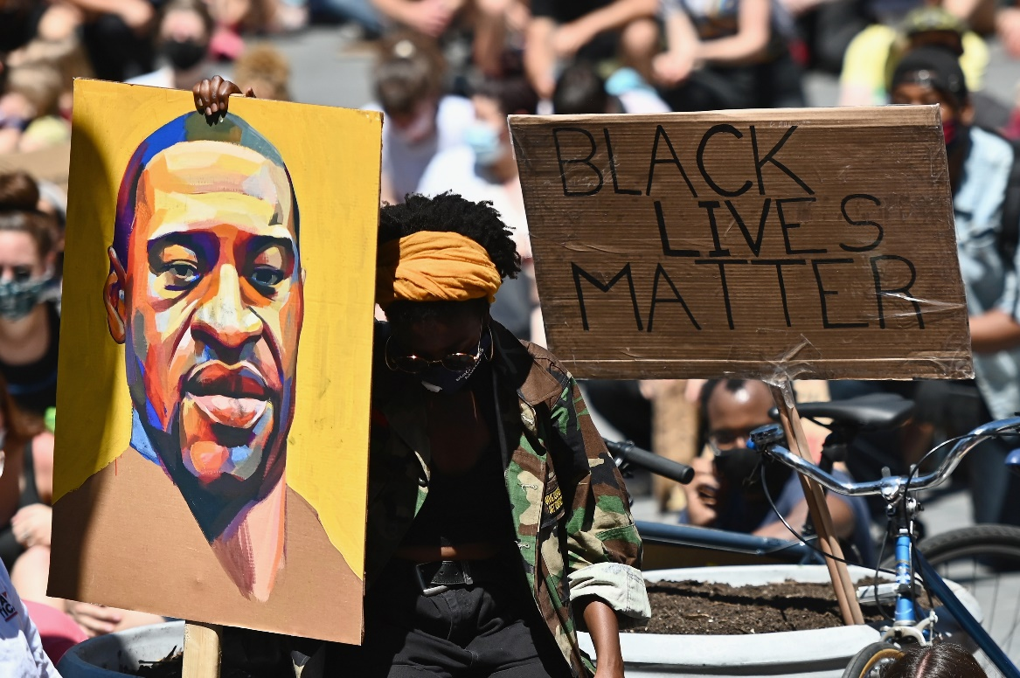

Slide 33
4. Manipulating children

Slide 34
The ‘Zone’: automatic behaviours; suggestibility

Slide 35
BINA48
Notes:
A manifesto. Gender and human have no material or biological foundations.; Upload your brain to the cloud (impossible, so this is really propaganda with no real science behind it)
No (religious or ethical) constraints on human wilfulness
A metaphysical rebellion, against God and material reality? Big money and coming markets.

Slide 36
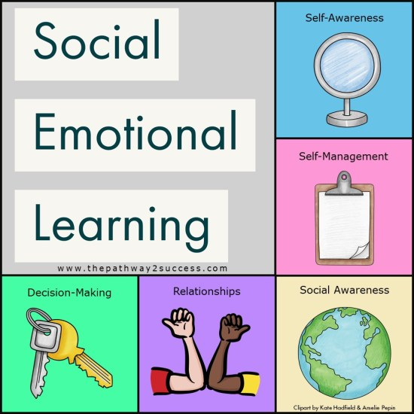

Slide 37
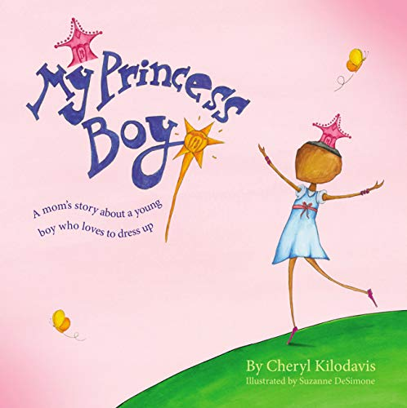
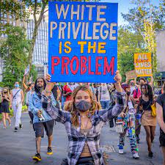

Slide 38
The structure of contemporary global governance?

